Slide 1





TEI-REX Program Closeout
Ballston Exchange Conference Center
Arlington, Virginia
January 21, 2026

Slide 2
Agenda
Performer Overall Proposed Strategy
Phase 1 accomplishment(s) and challenges
Phase 2 accomplishment(s) and challenges
Challenges to address IARPA requirements (biomarker/biodosimetry model)
Future research GAPs to be addressed
Lessons Learned (programmatic, technical)

Slide 3
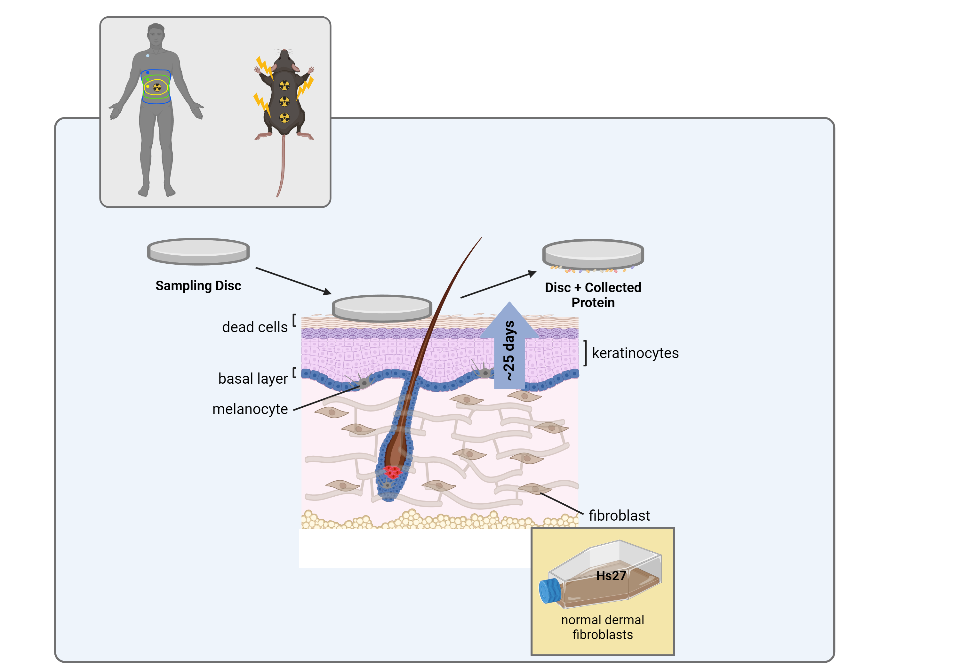
Overall Proposed Strategy
Start of Program:
Detection of known and unknown adducts by tandem mass spectrometry of protein digests and open modification searching
Modified early in Phase 1:
Detection of quantitative protein features for biodosimetry classification of dose, dose rate, time after exposure
Notes:
Make sure to say We never wanted mice. It was a backup plan.

Slide 4
UW Sample Summary
Phase 1:
Samples: Human skin discs, Mouse pelt, Mouse Fur, MatTek cultured skin
IR types: X-ray, neutron, and proton (UW only)
FA1/2: 25 and 90 days (human) = 6 and 25 days (mouse)
Phase 2:
Samples: Human skin discs, Mouse pelt, MatTek cultured skin, Mouse skin discs
IR types: X-ray and neutron
FA1/2: 25 and 90 days (human) = 6 and 25 days (mouse)

Slide 5
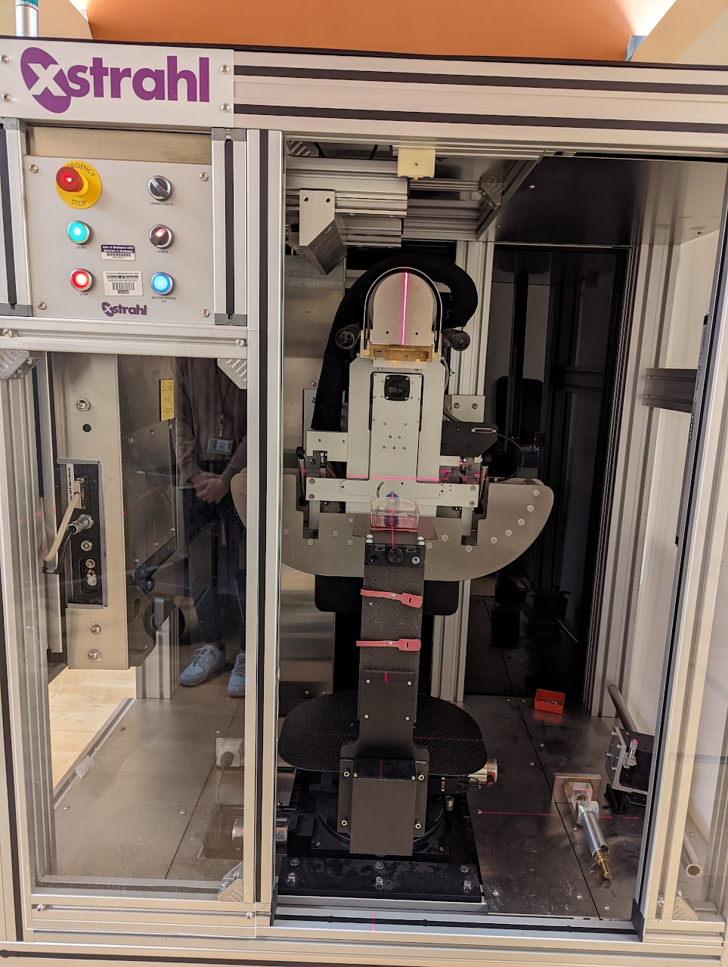
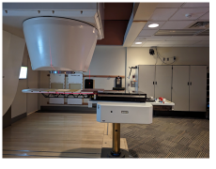
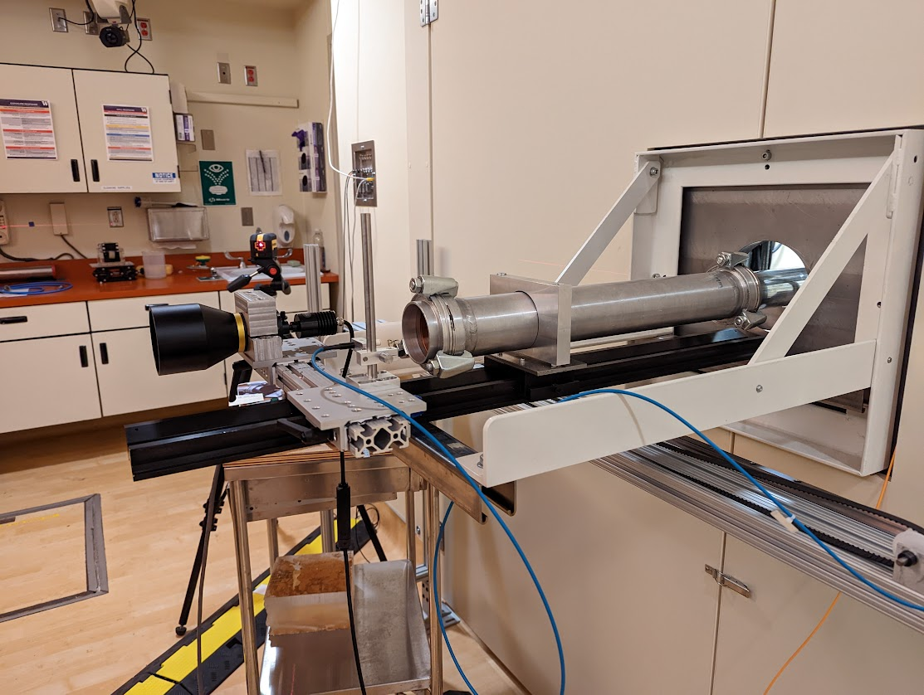
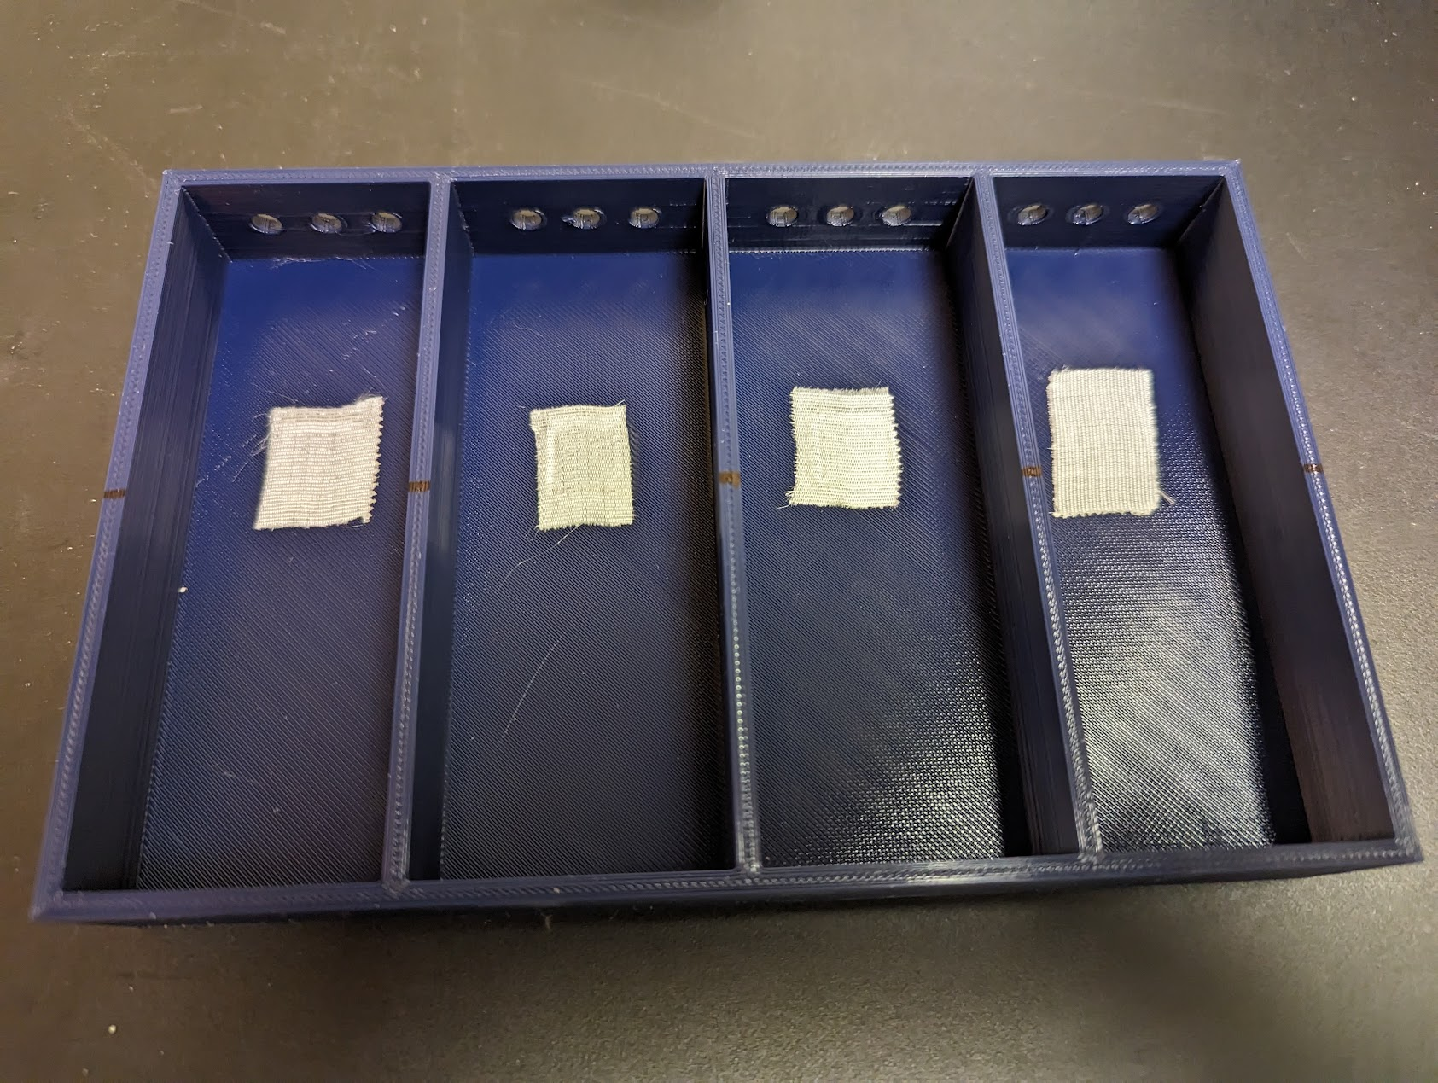
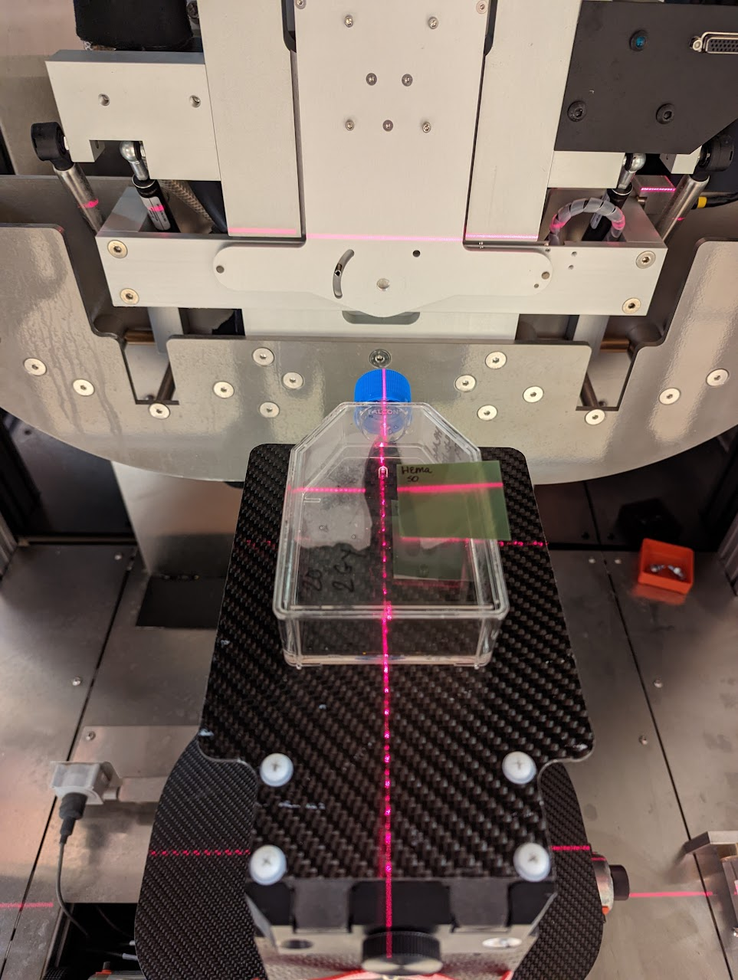
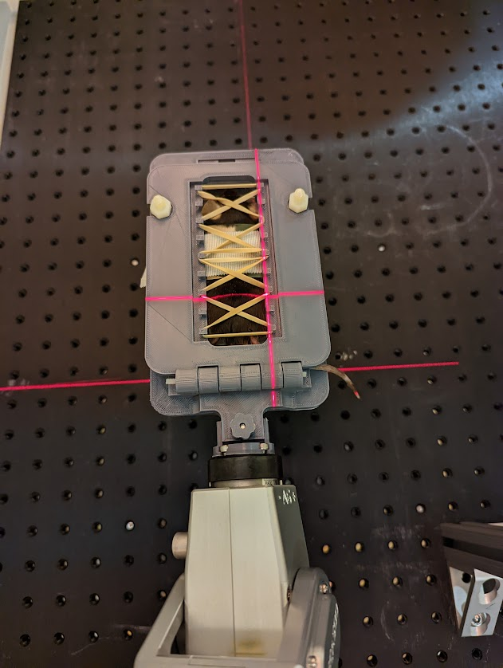
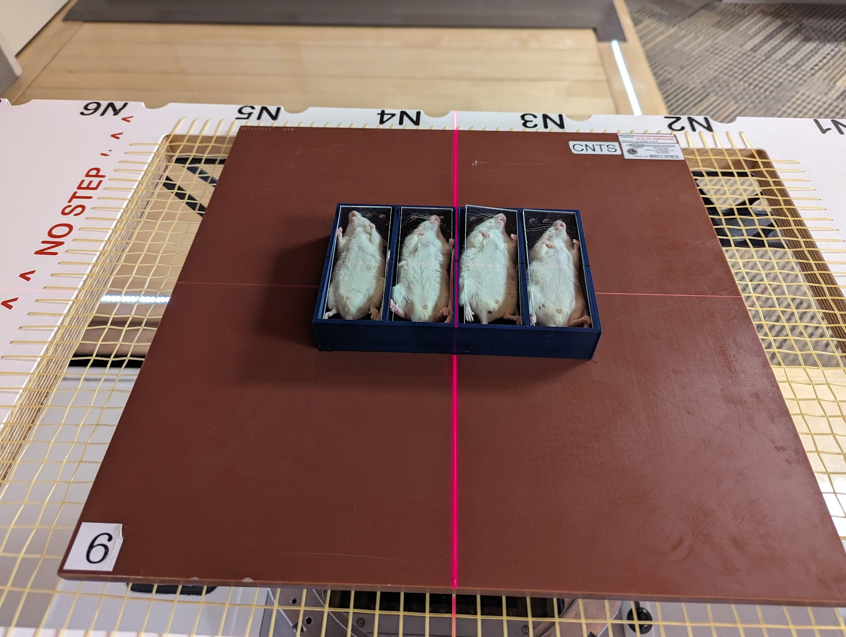
X-ray/Proton/Neutron Sample Generation
Cyclotron
(fast neutron)
Cyclotron
(proton)
FLASH/conventional dose rates
SARRP (Xray)

Slide 6
Phase 1 TE Challenge Samples
Phase 1A Samples (list):
Samples: Mouse pelt (543), Mouse Fur (286), MatTek cultured skin (126)
Mouse strains (C57BL/6, BALB/c), Sex (M, F)
IR types: X-ray
Dose: 1, 2, 4 Gy
FA1/2: 1, 6, 14, 92, 120, 154 days
Phase 1B Samples (list):
Samples: Mouse pelt (472), MatTek cultured skin (90)
Mouse strains (C57BL/6, BALB/c), Sex (M, F)
IR types: X-ray
Dose: 1, 2, 4 Gy
FA1/2: 1, 6, 14, 90, 130, 150 days
Success after using unblinded 1A samples to train for Phase 1B Samples

Slide 7
Automated Workstations Facilitate Processing

Slide 8
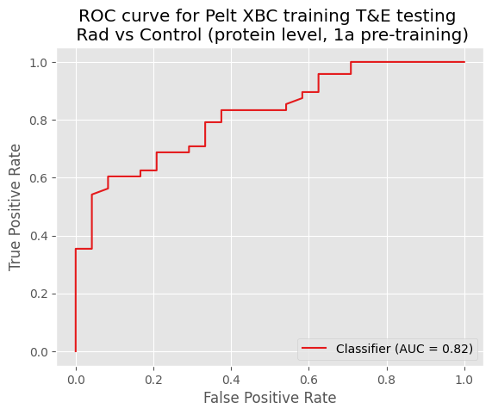
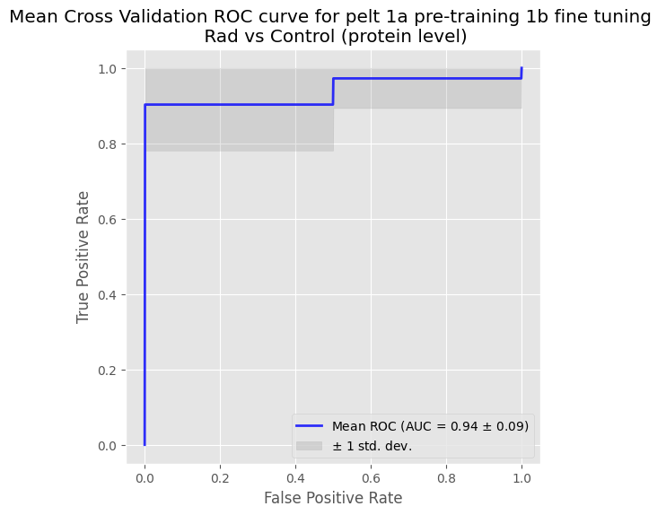
Fine tuning model for pelt with 1B training samples
Train on 1A and apply model to 1B
Train on 1A and finetune model to 1B
Notes:
Prediction of exposure to radiation
A model trained on 1a data generalizes reasonably well to the 1b data (0.82 AUC)
Further fine-tuning on the 1b training data gives slightly better results than training from scratch using the features selected from 1a (0.94 vs 0.90 AUC)

Slide 9
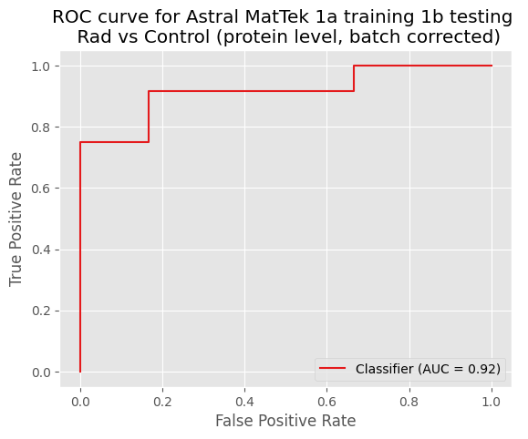
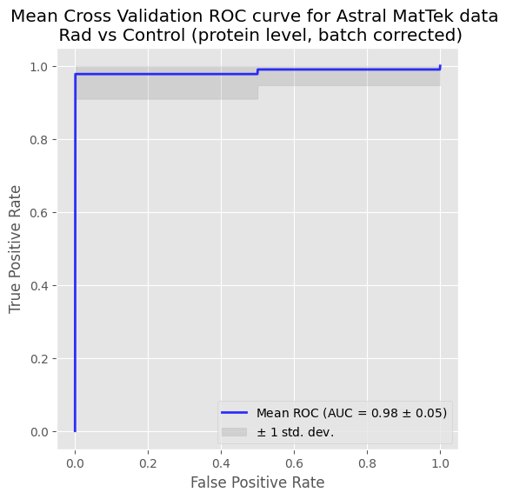
1a Training and 1b Testing After all MatTek Data Generated
Train on 1A and test on 1B
Cross validation on combined 1A & 1B data

Slide 10
Phase 1 Accomplishments
The same small set of protein features can be applied to classify independent studies
Able to distinguish between time since exposure and age in the mouse model
Approaching required number of training samples for robust classifiers
Differences in biological response to FLASH and conventional proton exposure have been identified
Demonstrated sensitivity below 1 Gy (75 cGy) for neutron exposure
IR-response observed in human disc samples after 20 days
Demonstrated utility of targeted PRM assay

Slide 11
Phase 1 Accomplishments
The same small set of protein features can be applied to classify independent studies
Able to distinguish between time since exposure and age in the mouse model
Approaching required number of training samples for robust classifiers
Differences in biological response to FLASH and conventional proton exposure have been identified
Demonstrated sensitivity below 1 Gy (75 cGy) for neutron exposure
IR-response observed in human disc samples after 20 days
Demonstrated utility of targeted PRM assay

Slide 12
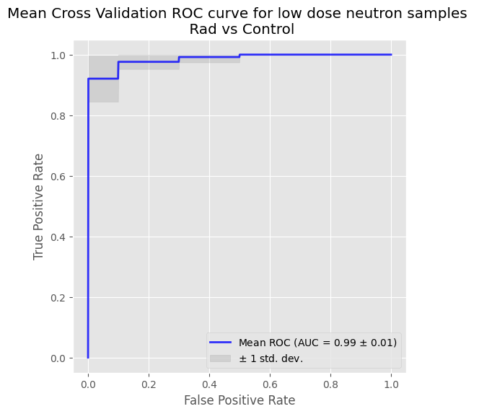
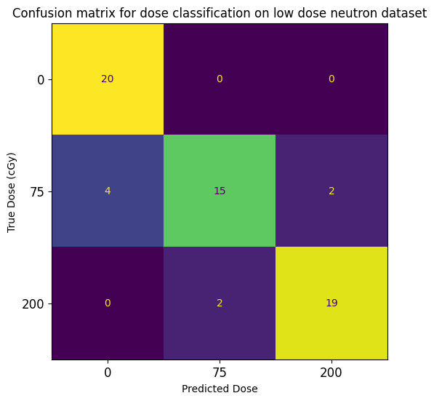
Low Dose Neutron Experiment
Phase 1 low dose neutron study resulted in very good discrimination of 0, 75, and 200 cGy
No misclassification of 0 Gy controls
Very few misclassifications of 75 and 200 Gy
Performance should improve further with additional training data

Slide 13
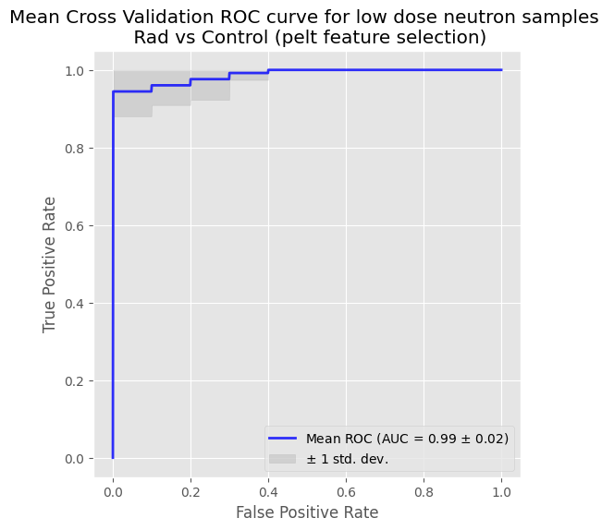
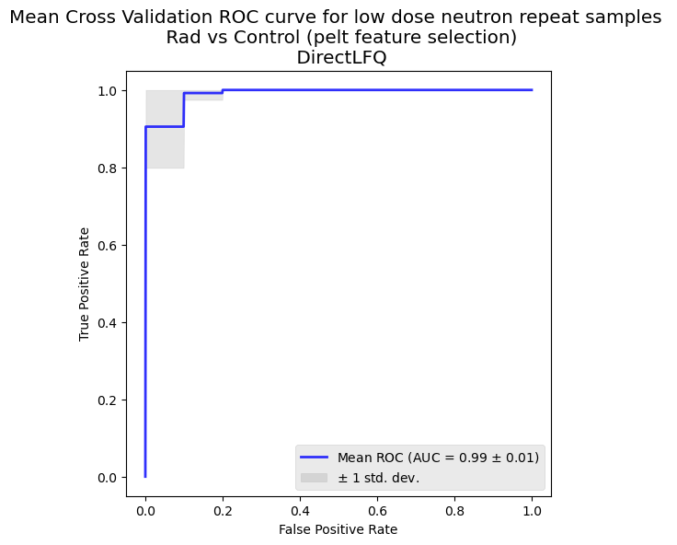
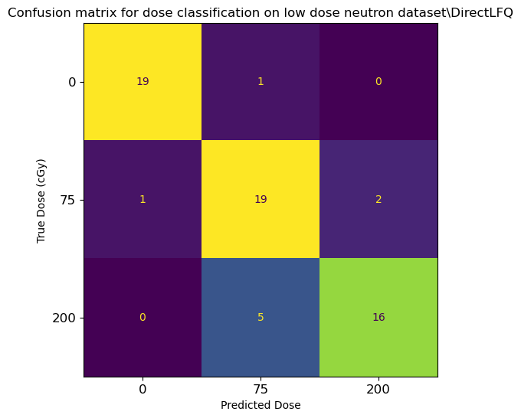
Low Dose Neutron Repeat (No protein normalization)
January 2024
June 2024
With protein normalization
Without protein normalization

Slide 14
X-ray markers translate to low dose neutron samples
Restricting to ~20 markers previously identified in X-ray pelt samples gave very good signal in a low dose neutron study
Independent cross-validation of neutron samples
Cross-validation restricted to 20 X-ray markers

Slide 15
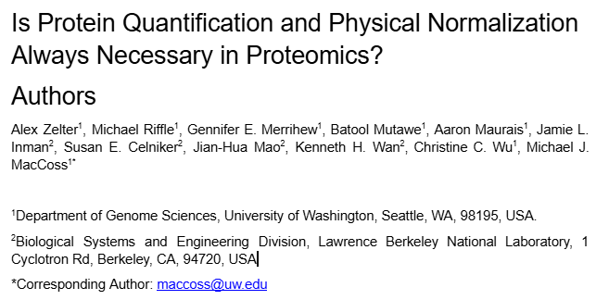
Normalization Paper

Slide 16
Phase 1 Accomplishments
The same small set of protein features can be applied to classify independent studies
Able to distinguish between time since exposure and age in the mouse model
Approaching required number of training samples for robust classifiers
Differences in biological response to FLASH and conventional proton exposure have been identified
Demonstrated sensitivity below 1 Gy (75 cGy) for neutron exposure
IR-response observed in human disc samples after 20 days
Demonstrated utility of targeted PRM assay

Slide 17
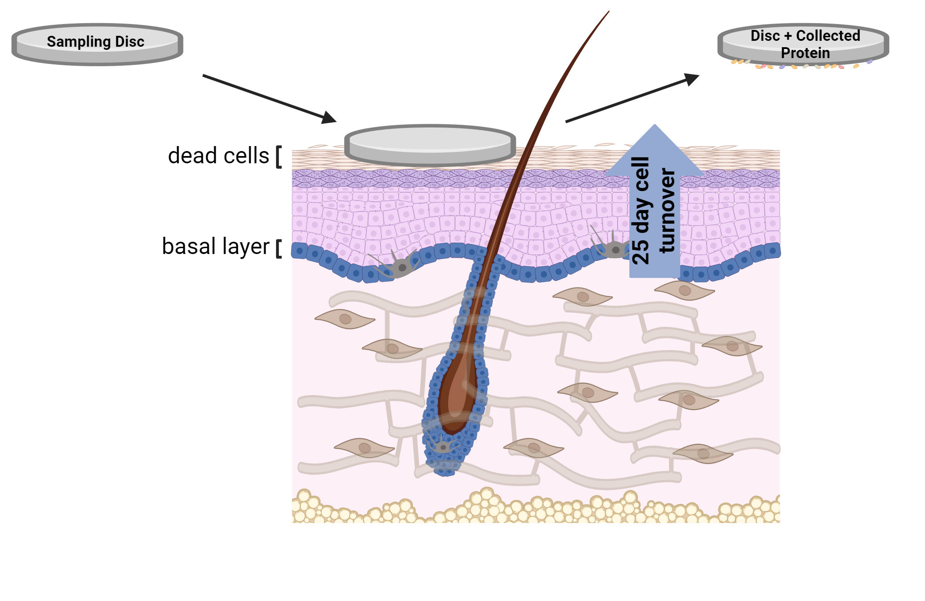
Non-Invasive Sampling of Human Skin

Slide 18
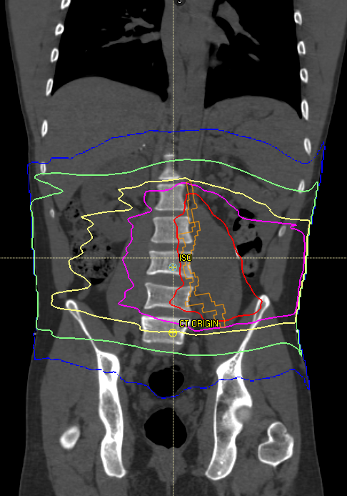
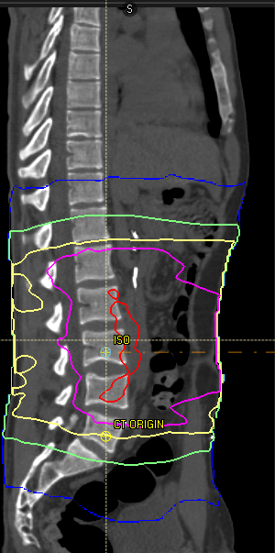
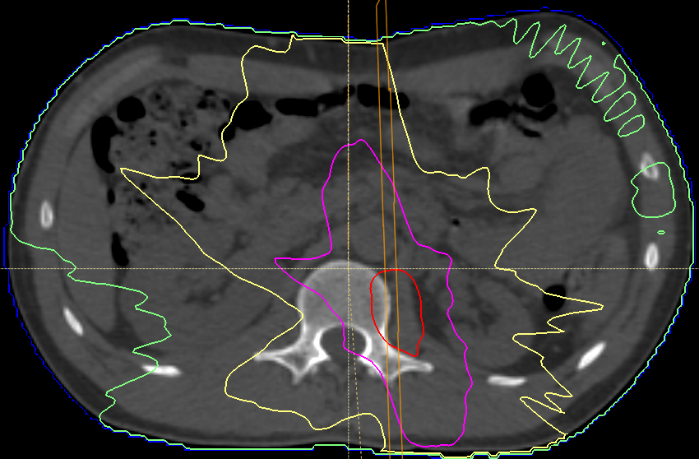
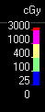
Instrument software automatically calculates dose boundaries
axial
Absorbed Dose Boundary
Blue line 0.25 Gy
Green line 1 Gy
Yellow line 4 Gy
Pink line 10 Gy
Red line 30 Gy
sagittal
coronal
Multiple samples at different doses from same subject
Enabled by automated mapping of dose boundaries
Notes:
Raystation was used to calculate these boundaries SBRT (Stereotactic Body Radiation Therapy) is a highly precise, high-dose form of radiation treatment that delivers focused beams to tumors in 1 to 5 sessions

Slide 19
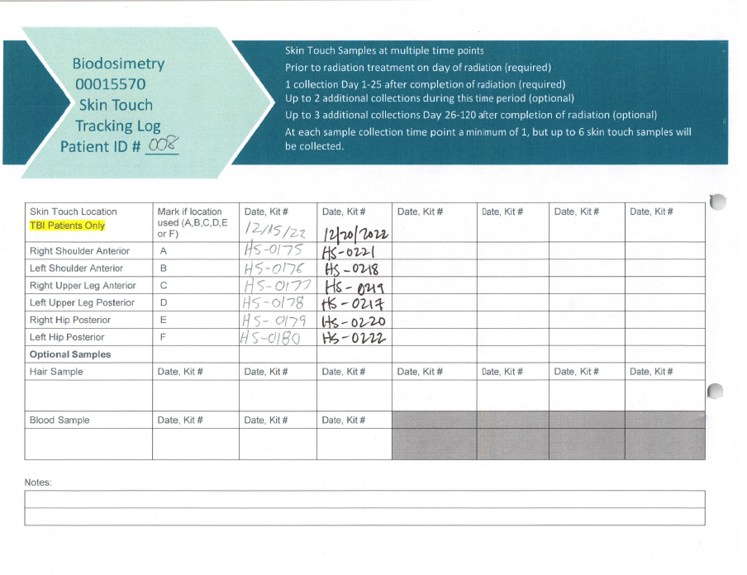
Human Recruitment and Sampling
TBI: 1.65 Gy

Slide 20
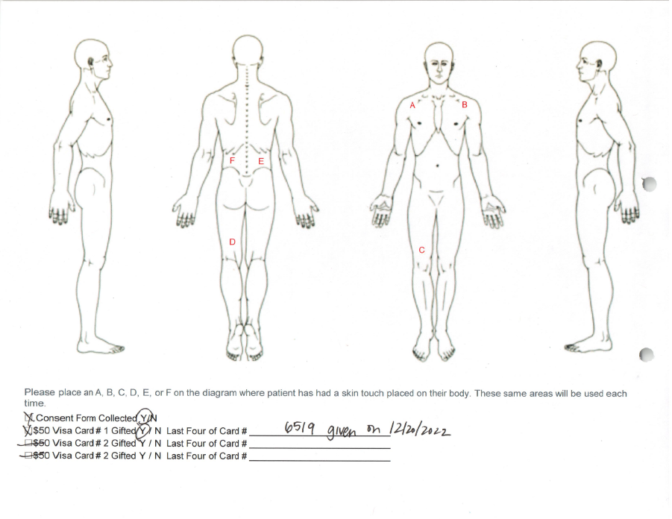
Human Recruitment and Sampling
Notes:
People’s body types were very different and the SBRT doses were considered unreliable

Slide 21
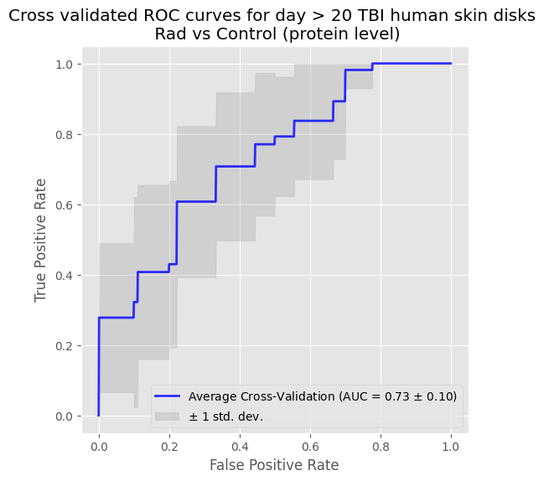
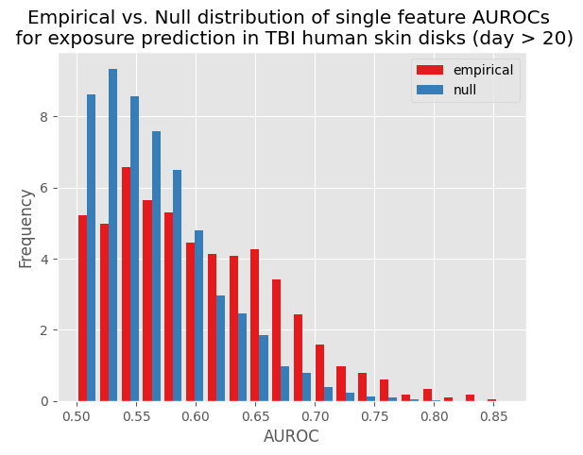
Markers of IR-response detected in human skin discs
TBI dosing (most samples between 200-400 cGy)
Performance improved by focusing on MatTek features
AUROC=0.73 is consistent with small number of training samples evaluated
Many MatTek features are also associated with radiation in human

Slide 22
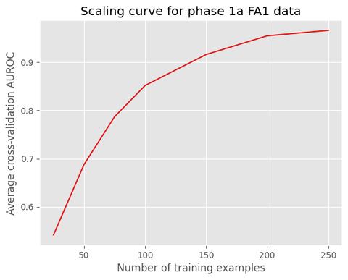
Performance in human matches expectations given small sample size
Borrowing features from MatTek samples improves performance on smaller datasets
Current analysis includes only n=34 TBI training samples at time > 20 days post exposure

Slide 23
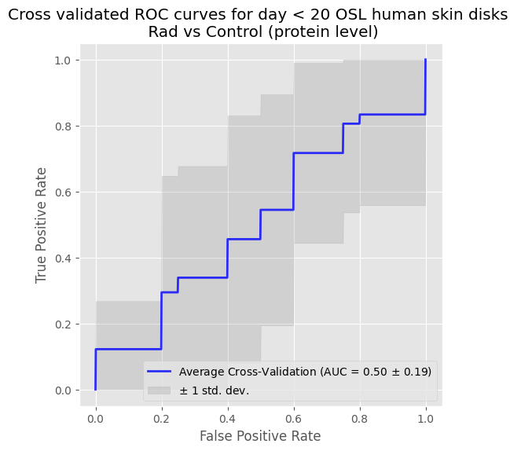
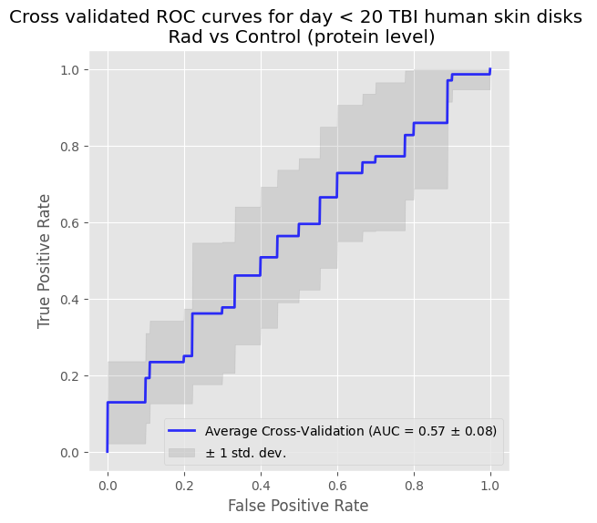
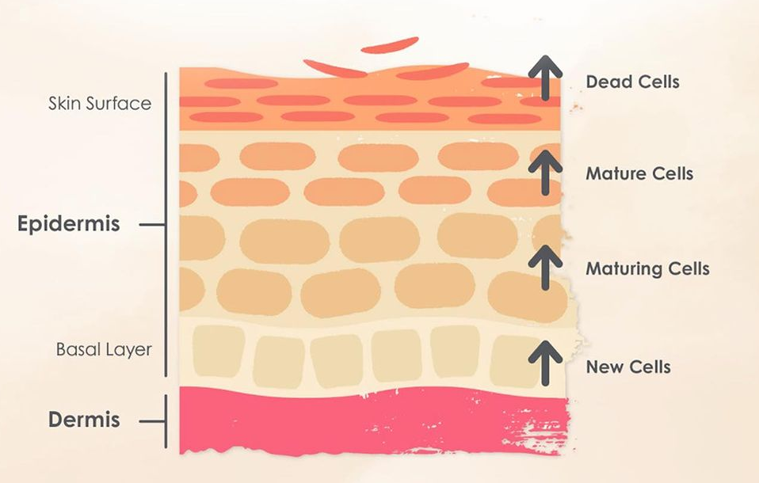
No signal <20 days after x-ray exposure
No IR signal observed when sampling <20 days after dose
Examined both targeted dosing (with dosimeters) and TBI dosing
May be related to 25-day migration of dermal cells to surface for sampling
~25 day migration to surface

Slide 24
Phase 1: Total Skin Discs (TBI Analysis)
Total:
17 patients
126 discs

Slide 25
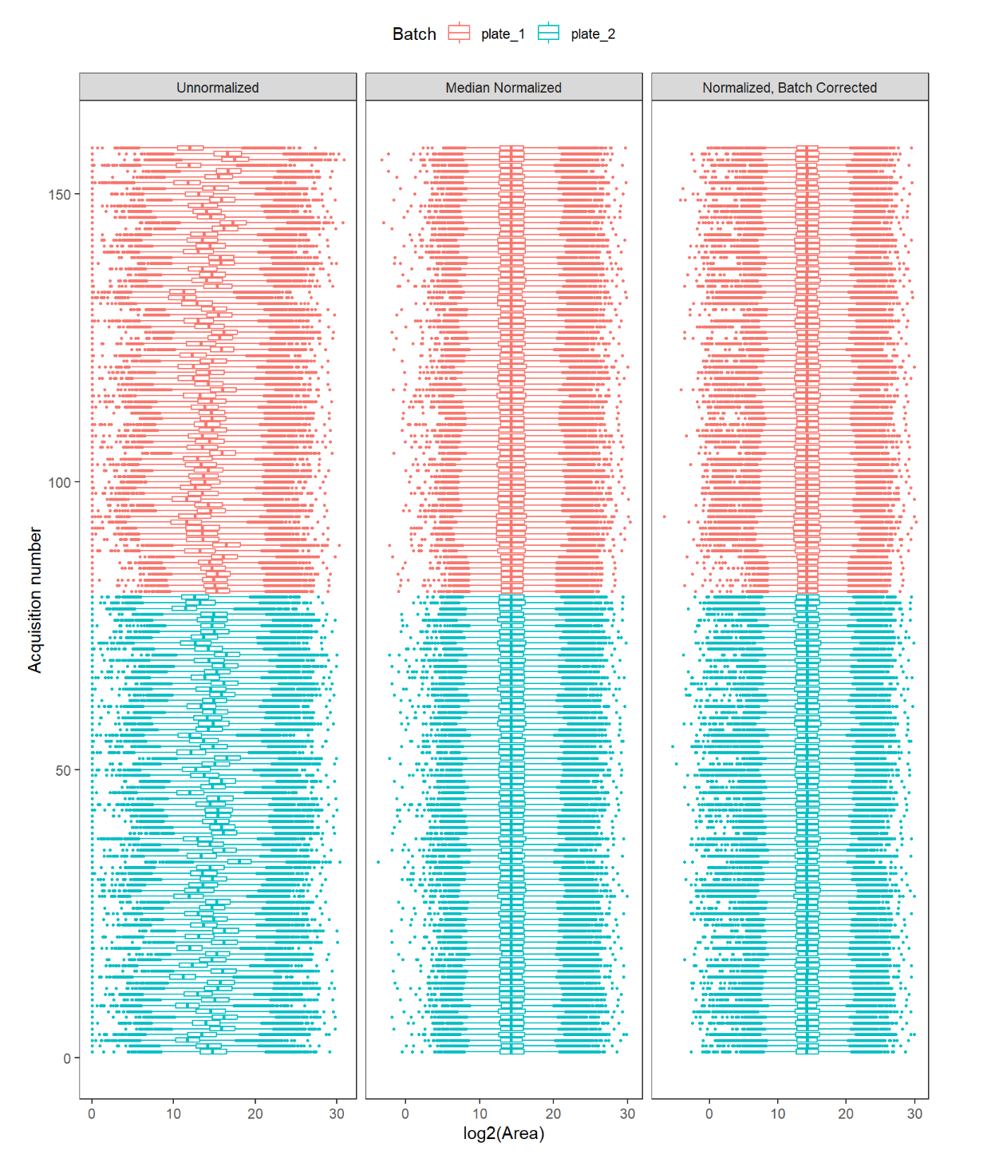
TBI Skin Disc Data Analysis
More sample-to-sample variability than pelt samples pre-normalization

Slide 26
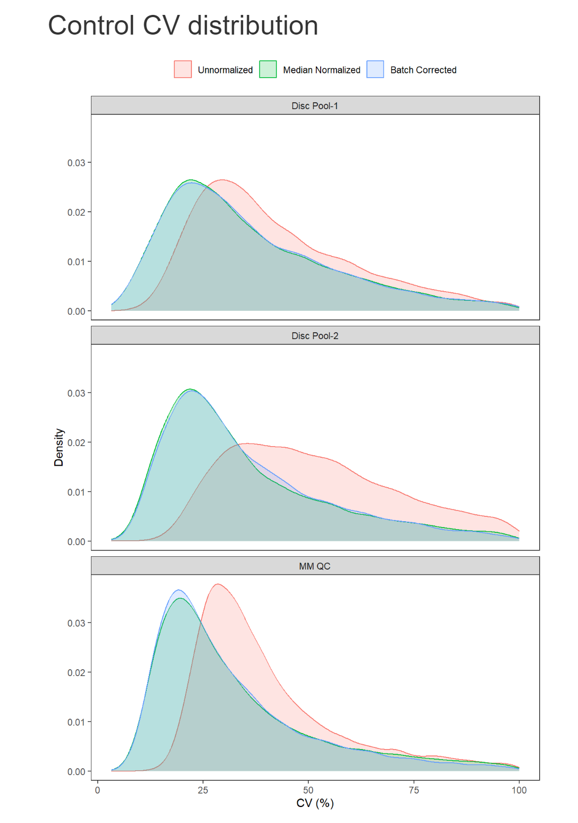
TBI Skin Disc Data Analysis
Plate 1 Only
Plate 1&2
Plate 1&2
Notes:
We had different controls in our experiment.
Some were pools of the extract from patient skin disks and others were discs sampled from an unexposed “healthy” volunteer

Slide 27
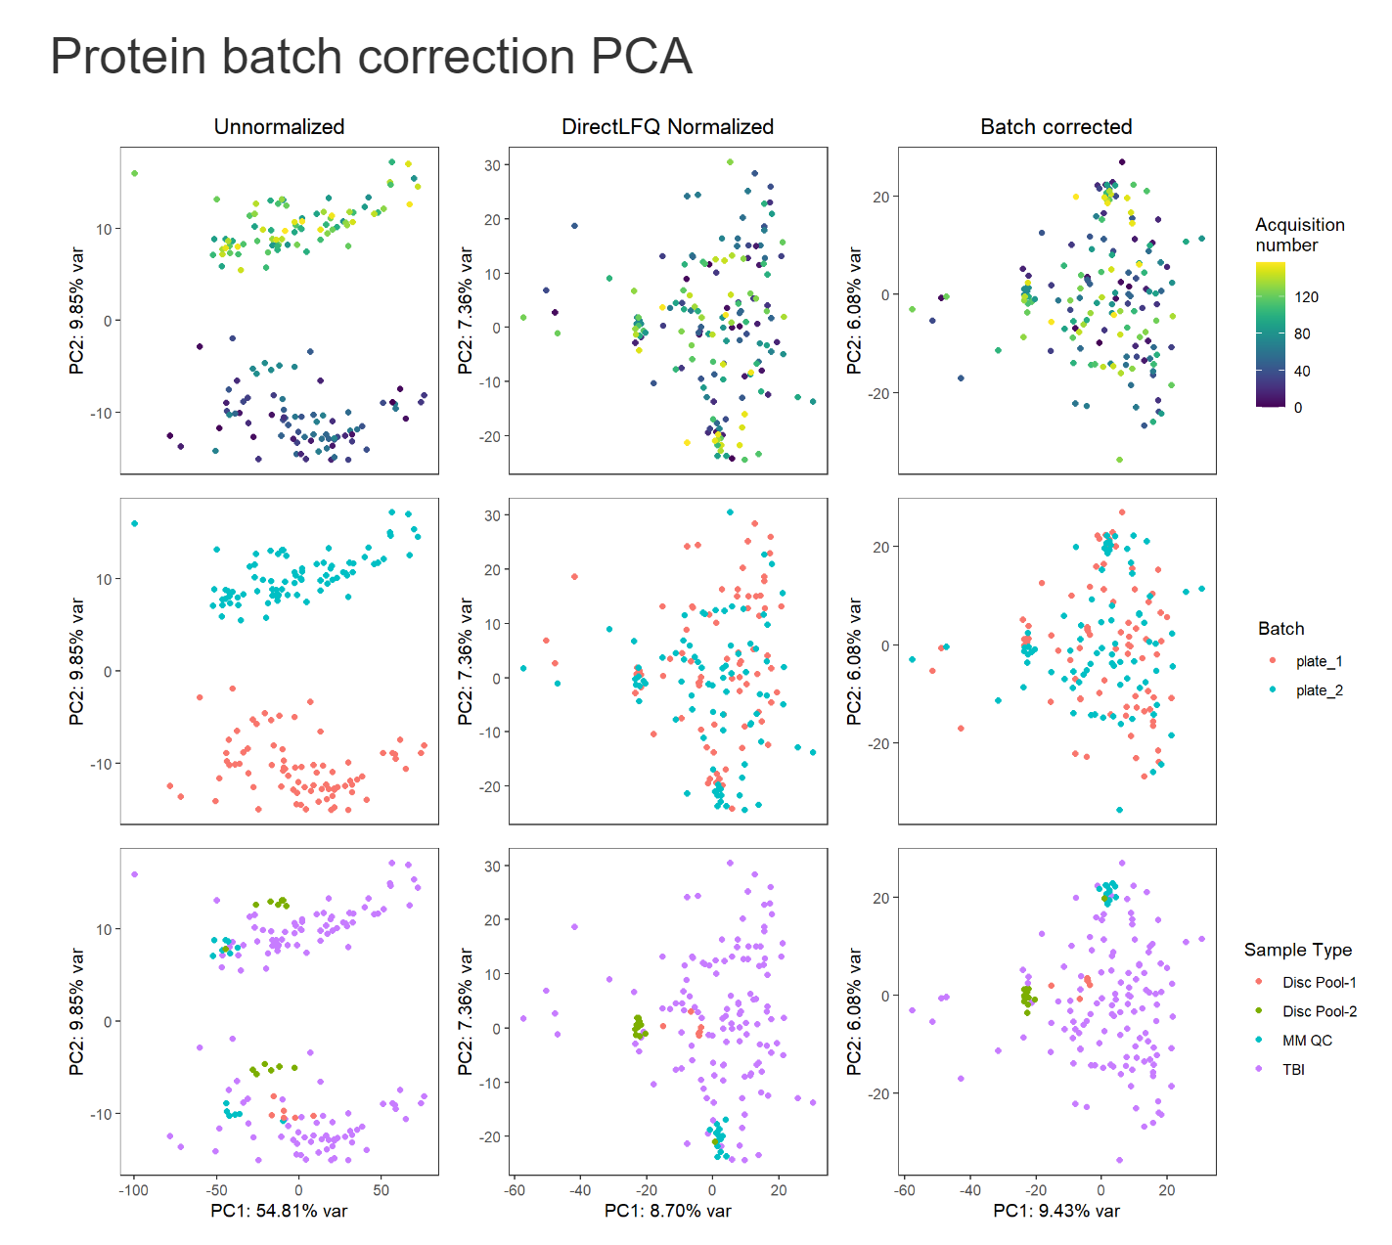
TBI Skin Disc Data Analysis
Separation by plate
Prior to normalization
Normalization alone seems to remove the plate batch effect
Clustering by Sample type as expected for controls

Slide 28
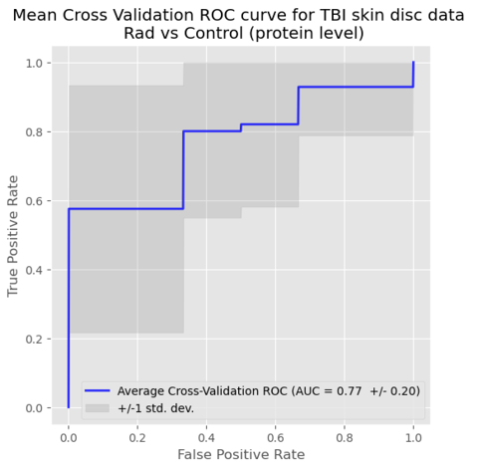
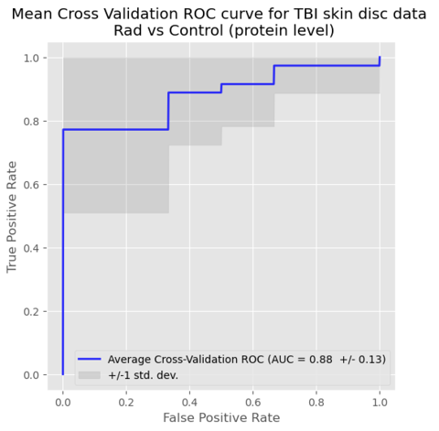
TBI Skin Disc Data Analysis (>20 Days Post Exposure)
Features found via previous MatTek analysis
Human ortholog features by sequence comparisons to mouse features
84 samples from 17 patients

Slide 29
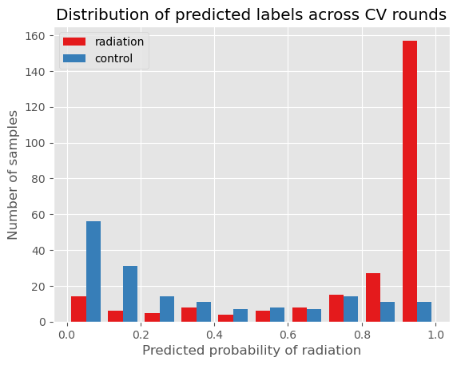
TBI Skin Disc Data Analysis
Looking at >20 days from exposure
Using mouse ortholog target list + parameter optimization

Slide 30
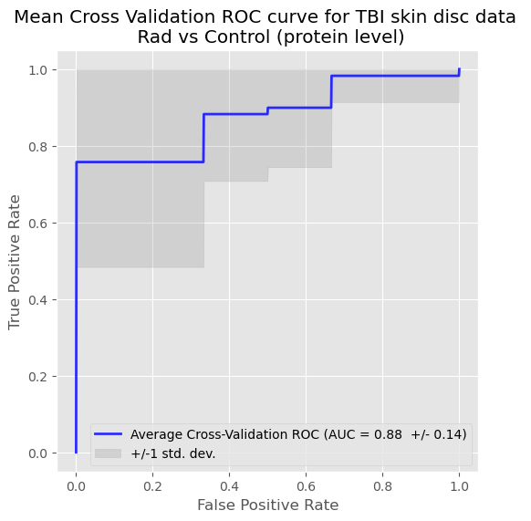
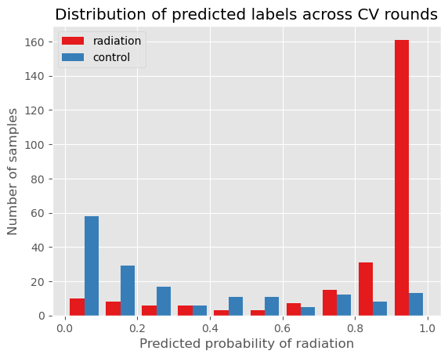
TBI Skin Disc – Using MatTek Features Don’t Add much
Features from Mouse Xray Experiments
Features from Mouse Xray & Human MatTek Experiments
Notes:
MatTek features don’t add much when we figured out how to use the mouse skin pelt features.

Slide 31
Performance in human matches expectations given small sample size
Current analysis includes only n=84 TBI training samples (17 individuals) at time >20 days post exposure

Slide 32
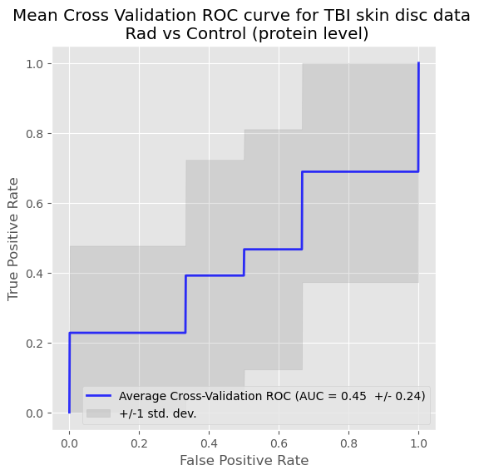
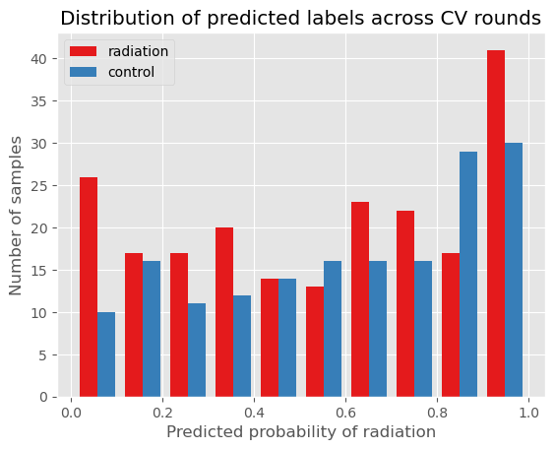
TBI Skin Disc Data Analysis
Looking at <20 days from exposure
76 samples from 17 patients

Slide 33
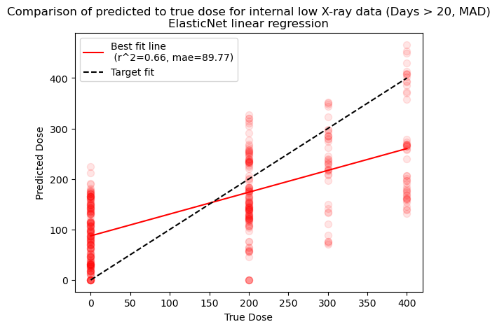
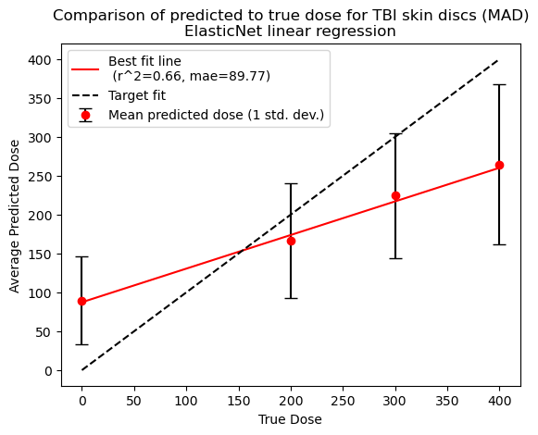
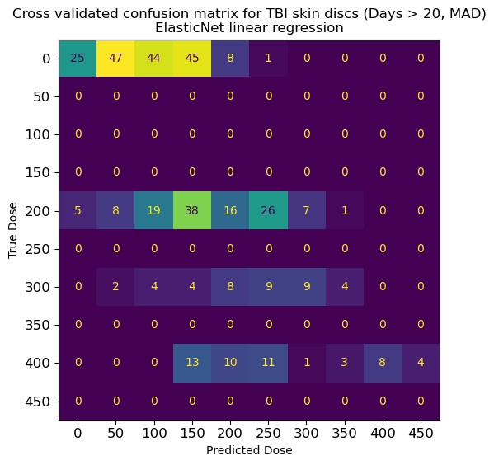
Skin Disc Dose Prediction (ElasticNet)
Notes:
One of the downside here is that we can predict almost any dose … but we only have a few doses.
Our 0 dose samples will almost always be predicted a low dose and not 0.

Slide 34
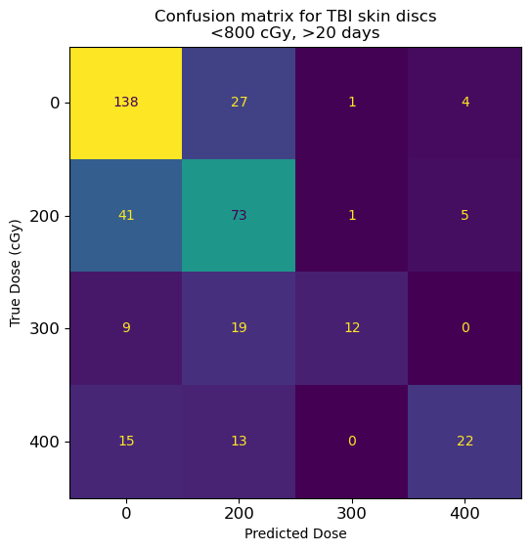
Skin Disks: XGBoost Classification
Notes:
Performing a multigroup classification makes this look better but we still struggle with predicting 0.

Slide 35
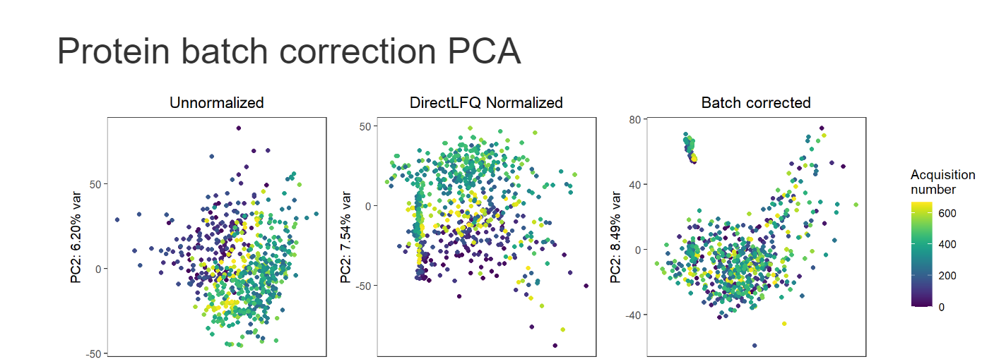
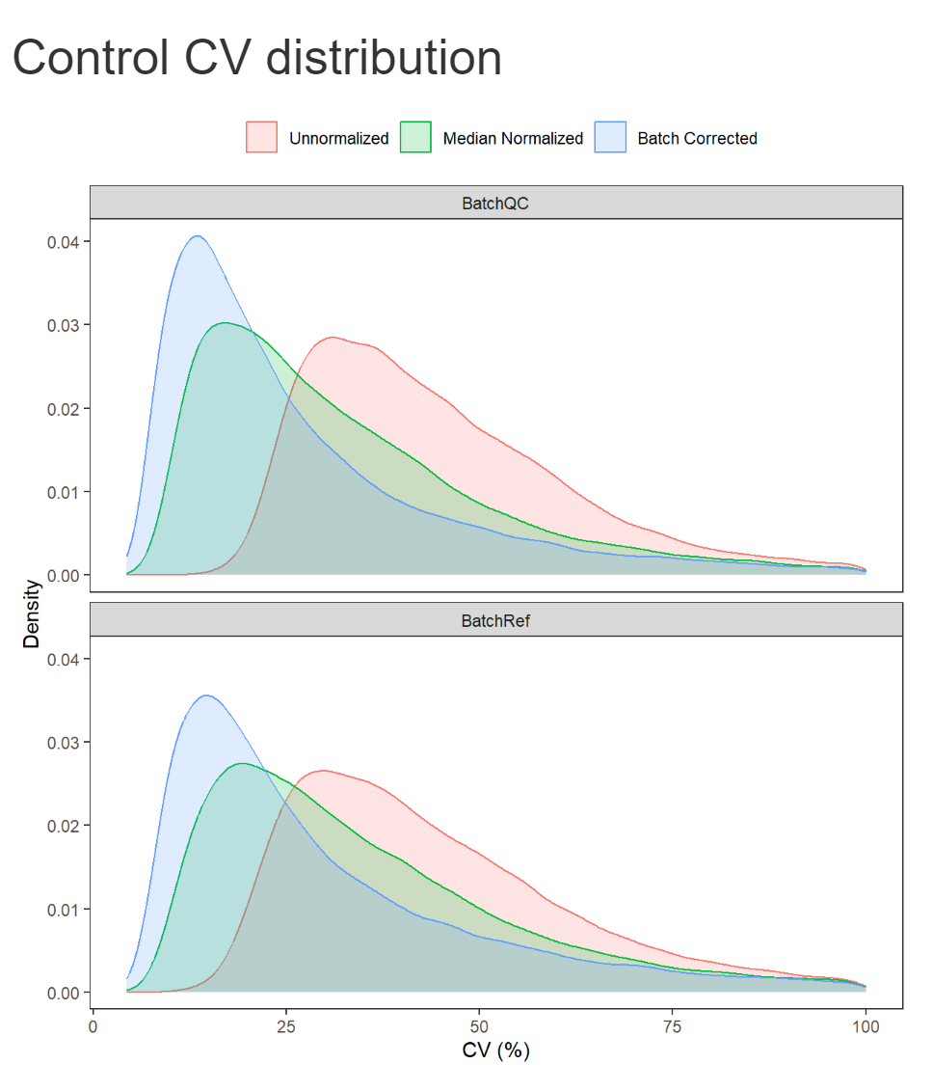
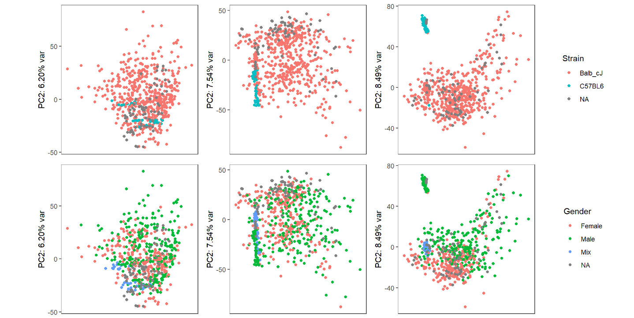
Downstream Normalization and Batch Correction for Large Studies (>96 samples)
Commonly observed batch effect occurring over time (~1 sample / hour). Corrected using directLFQ + ComBat.
Biological differences maintained
Precursor Intensity CVs of reference samples used to monitor computational steps
Aaron Maurais

Slide 36
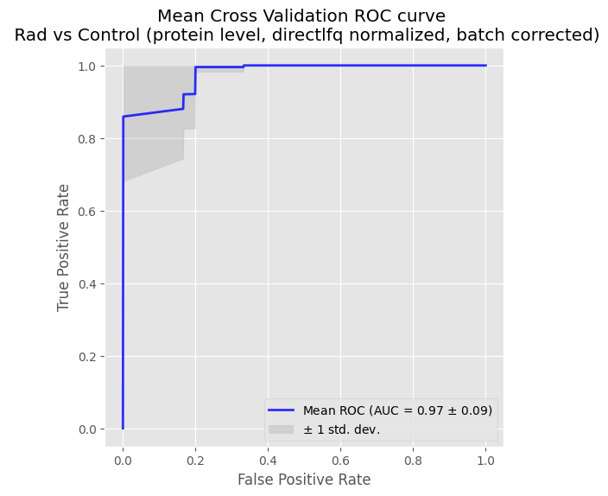
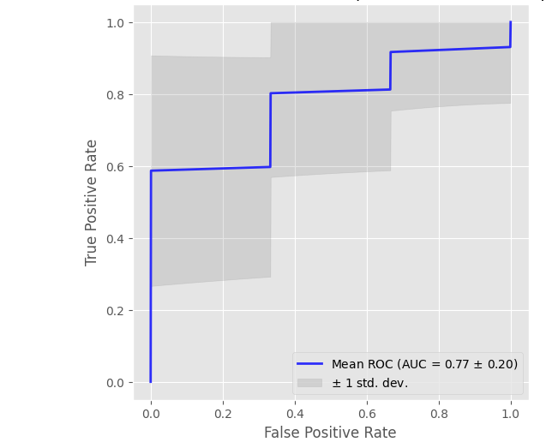
Dose Rate Separation in Mouse Model
Good separation of controls and irradiated samples
Dose rate (flash vs conventional proton radiation) is reasonably distinguished
Exposure Prediction
Dose Rate Prediction

Slide 37
Phase 1 Challenges
Sample generation challenges:
Even though we did well with dose rate separation, we stopped working on proton IR (Challenge limitation: no TE proton samples “for the test”; Logistic limitation: one mouse per exposure)
Human Skin Disc (TBI > >> SBRT) (Challenge limitation: TBI dose will be too high for Phase 2; Logistic limitation: ambiguous disc collection sites on patient
Data Analysis challenges:
More training samples required
More custom tools required for increased sensitivity

Slide 38
Phase 2 Accomplishments
Larger set of protein features can be applied to classify independent studies
Able to distinguish between time since exposure and age in the mouse model
Demonstrated sensitivity below 75 cGy for neutron and X-ray exposure
IR-response observed in human disc samples after 20 days
Developed a fully targeted PRM assay

Slide 39
Phase 2 TE Challenge Samples
Phase 2A Samples:
Samples: Mouse pelt (700), MatTek (244)
Mouse strains (C57BL/6), Sex (M)
IR types: X-ray
Doses: 10, 75, 100 cGy
Dose Rates: Low, High
FA1/2: 7, 21, 90, 150 days
Phase 2B Samples:
Samples: Mouse skin disc (1028), Mouse pelt (304), MatTek (288)
Mouse strains (C57BL/6, Collaborative Cross), Sex (M, F)
IR types: X-ray
Doses: 9, 23, 70 cGy
Dose Rates: Low, High
FA1/2: 7, 14, 21, 44, 58, 72, 90 days

Slide 40
Immediate Technical Issues
How are we going to process the data?
Needed to solve the missing data problem with tools like DIA-NN
How are we going to analyse ~1500 samples in a couple of months.

Slide 41

What our DIA workflow Does
Final output is a Skyline document that includes all results (and optional reports).
Workflow takes you from RAW files to Skyline to ProteomeXchange
Notes:
Main takeaway: You start with raw files and get a Skyline document. That may be optionally pushed to PanoramaWeb & ProteomeXchange

Slide 42


Challenge with Missing Data

Slide 43

Challenge with Missing Data
Simulation: 50 proteins, 5 samples/condition, 4x fold change, 20% CV

Slide 44
Imputation? Two options …
Do we make up low abundance quantities?
Do we use the background signal at the retention time and m/z values we know it exists?

Slide 45

Peak Boundary Imputation Provides a Lower Boundary for the Signal
Detected By DIANN
Not Detected By DIANN

Slide 46

Can recover a signal when search tools miss a peak

Slide 47


Differentially Abundant Proteins
Without Peak Boundary Imputation
With Peak Boundary Imputation

Slide 48


What are these extreme values?

Slide 49


Orbitrap Astral MS: Quadupole-Orbitrap-mrTOF
Heil et al. Evaluating the Performance of the Astral Mass Analyzer for Quantitative Proteomics Using Data-Independent Acquisition, J. Proteome Res. 2023
Hsu et al. Evaluation of a Prototype Orbitrap Astral Zoom Mass Spectrometer for Quantitative Proteomics – Beyond Identification Lists, J. Proteome Res. 2025

Slide 50



The Stellar MS: Quadupole-IRM-Radial Ejection Dual Pressure Linear Ion Trap
Remes et al. Hybrid Quadrupole Mass Filter – Radial Ejection Linear Ion Trap and Intelligent Data Acquisition Enable Highly Multiplex Targeted Proteomics J. Proteome Res 2024

Slide 51

Targeted Assay Generation
~8 proteins (green) from simple correlation
8 proteins (red) from XGBoost, 3 overlap with correlation
An additional 81 proteins (blue) provide the remaining classification capability.
~1% of the proteins measured are useful in the classification.
Proteins span >7 logs dynamic range.

Slide 52
Phase 2a Recap
Sample and data analysis​
Results​
Self-assessment

Slide 53

Pelt Sample Summary
700 T&E pelt samples
236 controls
936 total samples
10 plates

Slide 54

Pelt Plate 1

Slide 55
Pelt Data Collection Summary
Plate 1: 942.1 GB (72 T&E samples, 8 XP2P, 8 ET, and 8 DIRP)
Plate 2: 843.3 GB (72 T&E samples, 8 XP2P, 8 ET, and 8 DIRP)
Plate 3: 908.5 GB (72 T&E samples, 8 XP2P, 8 ET, and 8 DIRP)
Plate 4: 946.7 GB (72 T&E samples, 8 XP2P, 8 ET, and 8 DIRP)
Plate 5: 931.8 GB (72 T&E samples, 8 XP2P, 8 ET, and 8 DIRP)
Plate 6: 817.3 GB (72 T&E samples, 8 XP2P, 8 ET, and 8 DIRP)
Plate 7: 773.0 GB (72 T&E samples, 8 XP2P, 8 ET, and 8 DIRP)
Plate 8: 740.0 GB (72 T&E samples, 8 XP2P, 8 ET, and 8 DIRP)
Plate 9: 817.0 GB (72 T&E samples, 8 XP2P, 8 ET, and 8 DIRP)
Plate 10: 576.6 GB (52 T&E samples, 6 XP2P, 8 ET, and 6 DIRP)
>8.3 TB RAW Data 700 T&E samples, 78 XP2P, 80 ET, and 78 DIRP

Slide 56

Targeted Analysis of the Untargeted Data
Created a fasta file of just the “important” proteins
Radiation Features
92 protein targets from Phase 1
344 proteins from a peptide feature list
Top 20 pure Lasso features, top 20 stable Lasso features, and top 20 Boruta protein lists (33 unique proteins)
Combined them and removed duplicates -- 448 proteins
Proteins for Normalization, Alignment, etc…
1000 most abundant proteins from our evaluation of our sample preparation strategy
Combined the top 1000 proteins and the 448 protein targets.
Removed redundancies. 1341 total proteins
There were 31 proteins from the target list not in the most recent mouse fasta annotations. About 20 were contaminants.
1310 proteins … added back Yeast Enolase and Trypsin (1312 proteins)
Create a Fine-Tuned AI predicted library of spectra and RTs.
Used an Astral datafile from a pool to perform the fine tuning.
TRX_Phase2_Pelt-P01_Ast_Neo_REF-XP2P-001_008.raw

Slide 57
Database Search and Quantitation
Used DIA-NN v1.9.2 to search the AI generated library
diann --dir E:\Users\maccoss\TRX-Phase2-Pelt-Astral\Plate1-quant\ --dir E:\Users\maccoss\TRX-Phase2-Pelt-Astral\Plate2-quant\ --dir E:\Users\maccoss\TRX-Phase2-Pelt-Astral\Plate3-quant\ --dir E:\Users\maccoss\TRX-Phase2-Pelt-Astral\Plate4-quant\ --dir E:\Users\maccoss\TRX-Phase2-Pelt-Astral\Plate5-quant\ --dir E:\Users\maccoss\TRX-Phase2-Pelt-Astral\Plate6-quant\ --dir E:\Users\maccoss\TRX-Phase2-Pelt-Astral\Plate7-quant\ --dir E:\Users\maccoss\TRX-Phase2-Pelt-Astral\Plate8-quant\ --dir E:\Users\maccoss\TRX-Phase2-Pelt-Astral\Plate9-quant\ --dir E:\Users\maccoss\TRX-Phase2-Pelt-Astral\Plate10-quant\ --lib .\TRX-Phase2-Pelt-Plate4-diann_carafe_spec_lib.tsv --threads 36 --verbose 1 --out .\DIANN-Output\report.tsv --qvalue 0.01 --matrices --out-lib .\DIANN-Output\report-lib.parquet --gen-spec-lib --reannotate --fasta .\TRX-MousePelt-IR_Target+1000.fasta --min-pep-len 7 --max-pep-len 30 --min-pr-mz 400 --max-pr-mz 900 --min-pr-charge 2 --max-pr-charge 3 --cut K*,R* --missed-cleavages 1 --unimod4 --use-quant --conservative --individual-mass-acc --individual-windows --reanalyse --relaxed-prot-inf --rt-profiling --global-norm
Ran on a single server with a NUMA server (36 processors and 72 logical processors), 512 GB RAM, 14.5 TB SCSI SSD
Took 24.01 hours
Imported the DIA-NN results for each plate into Skyline-daily
Generated 10 skyline documents
Used lowess alignment and imputed the missing peak boundaries using a prototype build of Skyline
Created custom protein level reports

Slide 58


Assessment of the Boundary Impute vs Abundance Impute
Notes:
Imputing boundaries works better than imputing abundances.

Slide 59



All T&E 2a Pelt Batches
PC1: 44.11% var PC1: 20.62% var PC1: 26.72 var

Slide 60


Low vs Higher exposure in pelt 2a samples
FA1
0, 10, 25 vs 50, 75 cGy
FA2

Slide 61


Pelt FA1 cross validated vs blinded dose predictions
How we predicted we would do
How we did on blinded samples
Notes:
Our cross-validation strategy was very accurate in our ability to predict how well we would perform with T&E

Slide 62


Pelt FA1 cross validated vs blinded exposure predictions
How we predicted we would do
How we did on blinded samples
Notes:
Our cross validation strategy was very good at predicting how well we would do with blinded samples from T&E.

Slide 63


Pelt FA1 cross validated vs blinded dose rate predictions
How we predicted we would do
How we did on blinded samples
Notes:
We had no ability to predict dose rate.

Slide 64


Pelt FA1 cross validated vs blinded time since exposure predictions
How we predicted we would do
How we did on blinded samples

Slide 65
Phase 2a Recap
Tried to assess why did we did so bad?

Slide 66

Unblinded data – Review Performance
First, how well do we do on spiked-in UW samples? Samples spiked into same plates as T&E samples using same block randomization scheme.
Classifying no exposure vs/ exposure
Quite well: block randomization across plates, bench work, mass spec, processing pipeline worked.
Notes:
We did pretty well with our own samples prepared and run as controls within the experiment.
This means we did a good job at preparing the samples, collecting the data, handling normalization and batch correction.

Slide 67

Unblinded data – Review Performance
Unblinded FA1 samples
This is a slightly easier test than the UW evaluation, here we are classifying low vs/ high exposure (<50 cGy vs/ >50 cGy).
Signal definitely present, though not especially strong.
Can we determine why?

Slide 68





Examine performance differences by T&E batch
17
19
22
23
Notes:
After unblinding we worked with T&E to see if there were additional confounders
Turns out we did better on some of their internal batches than others.

Slide 69



Combining batches with batch 17
Combining data should yield better results.
Batch 17+19 Worse than 17 alone
Batch 17+22 Worse than 17 alone
Batch 17+23
This is the only performance gain

Slide 70



What about time since exposure?
6 and 7 days post exp.
14 days post exp.
20 and 21 days post exp.
Note: only 12/72
samples are > 50 cGy
Notes:
Most of our internal data was in the 6-7 days post exposure.
We always treated 25 days as FA2.

Slide 71

Distribution of time since exposure by T&E batch
OK
Bad
OK
Bad

Slide 72






Signal from top biomarkers fade after day 7

Slide 73


Using Time Since Exposure Improves the Model

Slide 74
Phase 2a: Take aways
Do very well with the shorter times since exposure within FA 1
Struggled with longer times since exposure within FA1
Batch 22 was harder because of a higher proportion of longer times since exposure
Batch 23 not sure what is happening. Makes predictions better when combined with 17. Not good by itself
Batch 19: There is an issue here, but don’t know what. Open to suggestions.

Slide 75
Low dose Neutron Regression Study
Pelt analysis

Slide 76


Low Dose Fast Neutron Experiment

Slide 77


First Attempt at ElasticNet Model
After some parameter optimization

Slide 78


Is there Signal at Low Doses?

Slide 79




Dose Response for Individual Markers
Q61878 PRG2_MOUSE: Eosinophil granule major basic protein; predominant constituent of the crystalline core of the eosinophil granule; secreted protein involved in antiparasitic defense mechanisms;
P49290 PERE_MOUSE: Eosinophil peroxidase; mediates tyrosine nitration of eosinophil granule proteins; enzyme is released at sites of parasitic infection to mediate lysis of protozoa or parasite;
Q9D379 HYEP_MOUSE: Epoxide hydrolase; critical biotransformation enzyme that converts epoxides to diols which can be conjugated and excreted from the body;
Q07813 BAX_MOUSE: Promotes activation of CASP3, and thereby apoptosis; Accelerates programmed cell death by binding to and antagonizing the apoptosis repressor BCL2; involved in epidermal response to UV irradiation

Slide 80




Dose Response for Individual Markers
P97425 ECP2_MOUSE: Eosinophil cationic protein 2; Eosinophil secondary granule ribonuclease 2; mediates tissue remodeling and cytotoxic activity
Q923L6 Q923L6_MOUSE: Eosinophil associated ribonuclease 10; Eosinophil secondary granule ribonuclease 10; mediates tissue remodeling and cytotoxic activity; involved in innate immune response in mucosa
P97426 ECP1_MOUSE: Eosinophil cationic protein 1; Eosinophil secondary granule ribonuclease 1; mediates tissue remodeling and cytotoxic activity
Q91X52 DCXR_MOUSE: Dicarbonyl and L-xylulose reductase; expression of DCXR in human skin (normal keratinocytes, melanocytes and endothelial cells) and increased in melanomas; cell adhesion function

Slide 81



Continued Improvement and Refinement of the Dose Prediction
Signal Normalization is an Important Parameter to Optimize
DirectLFQ
Totally Un-normalized
Median MAD

Slide 82


Confusion Matrix Based on Binned Dose Predictions
DirectLFQ
Median MAD

Slide 83
Low dose X-ray regression study
Pelt analysis

Slide 84




Low Dose X-ray Regression Experiment
Pelt samples collected at Day 6
**Plasma being analyzed as dosimetry proxy
Upper
Lower

Slide 85


Low Dose X-ray Dose Prediction

Slide 86


Low Dose X-ray Dose Prediction

Slide 87
Low dose neutron and X-ray Plasma EVs (control for radiation phenotype)

Slide 88



Low Dose Neutron (+/- exposure)
0 vs 75 cGy
0 vs 2 Gy
2 Gy vs 75 cGy

Slide 89


Low Dose Neutron Regression Dose Prediction

Slide 90



IR Typing (Neutron vs Xray) Using Plasma EVs
>75 cGy No Feature Selection
>75 cGy w/ Feature Selection
>32.5 cGy w/ Feature Selection

Slide 91
Low dose Human Skin Disc

Slide 92


Phase 2 Skin Disc Collection
Raystation image
Human skin discs collected from SBRT lung cancer patients in areas receiving <75 cGy as well as 2 other locations
3 sets of discs taken from chest/abdominal skin surface (CT origin, 5 cm superior, 5 cm inferior)
Rigid ruler used for consistent spacing from CT origin to enable consistency of sample location between time points and for Ray Station determination of dose

Slide 93


TBI Human Disc Analysis (+/- Exposure)
Compare late vs early days TBI
1-8 days
>42 days
1-8 days
>42 days
Transition to Peptide Rollup: Sum
Peptide to Protein Rollup: Sum Normalization: RT Lowess
Transition to Peptide Rollup: Library Assist
Peptide to Protein Rollup: Median Polish Normalization: RT Lowess

Slide 94



SBRT Separation by Dose
≥100 cGy
≥200 cGy
≥ 400 cGy
Transition to Peptide Rollup: Library Assist
Peptide to Protein Rollup: Median Polish Normalization: RT Lowess

Slide 95


SBRT Separation of Early versus Late Sampling
≥100 cGy, Day < 65
≥100 cGy, Day > 65
Transition to Peptide Rollup: Library Assist
Peptide to Protein Rollup: Median Polish Normalization: RT Lowess

Slide 96
Lessons Learned
For low dose (and low signal experiments in general), essential to first focus on feature detection experiments.
Use higher doses and as few variables as possible (phase 1a and 1b)
E.g., all the same sex, strain, etc
Give statistical power to feature selection
Low dose classifiers and regression is not possible without this
Can refine better classifiers downstream with less data if we know the protein features
Future experiments in mouse and human skin disc should focus on feature detection phases first.
Lots to be gained by improved signal processing. Need more effort.

Slide 97

Additional Funding from DOE
Custom Xstrahl X150 small animal radiation platform
Delivers X-rays at 6 mGy/hr to free-roaming mice
160 kVp, 3.2 mA, and filtered with 8 mm Cu
5/5/25-5/9/25-Installation
3 orthogonal methods of dosimetry (NIST-traceable) used to characterize the beam and map the field
Calibrated Fluke survey meter
TLD100 in TBI 25g mouse phantoms
Exradin A5 ionization chamber
Colosseum Experiment 1 complete
60 C57LB/6 (females, 14 weeks)
45 irradiated (100 mGy over 22 hours), 15 sham irradiated in shielded enclosure
Endpoints (1, 2, 6 days post-IR)
Tissues (plasma EVs, thymus, spleen) processed and analyzed by DIA LC-MS/MS (Orbtrap Astral Zoom)
Signal detected in plasma EVs

